Slide 1
Using Dijkstra’s Algorithm to Simulate the Flow of Electricity between Power Stations
Drew Aaron, Michael Beaver, and Andrew Hamilton

Slide 2
System Design
This system consists of class compositions
Graph is composed of Node and Edge
Edge is composed of Nodes
Node is the elementary object
The Graph also has-a min-priority binary heap
The user may create Graph objects and manipulate them in various ways
Such as adding Nodes and/or Node-Edge adjacencies
This system allows the user to input data either manually or by file (supports file loading and saving)

Slide 3
Front-End Design
The front-end design is completely user-oriented
The driver has a menu that allows the user to make different choices relating to the Graph
The driver program supports file I/O
Data may be loaded from a formatted file
Nodes may be inserted later
Data may be saved to a formatted file
The user may manually insert single Nodes and/or Node-Edge adjacencies

Slide 4
Front-End Implementation
The driver operates on a switch-case statement
Each menu option is represented by a character
Each case statement behaves according to the menu option’s description
Each method call in the case statements is tied to a back-end (i.e., Graph) method
For example: graph.readFromFile(input);

Slide 5
Tying the Front-End to the Back-End
When the user makes a menu selection, the proper back-end method is called via the Graph object
The user’s input is transferred to the back-end, which performs specific operations based on the input
User input is passed as method arguments
Relevant information will be displayed on the screen
The Graph object essentially acts as the connection between the front-end and the back-end
The data passed back-and-forth and the Graph class methods act as the tie between each end

Slide 6
Back-End Design
The back-end is comprised of three main components:
The Graph class, which is comprised of Nodes and Edges
The Edge class, which is comprised of Nodes
The Node class, which is the most elementary component
Ideally, the user would only ever need to create a Graph object
Node pointers might be needed for case-handling during insertion, etc., but this is rare
The Graph class contains all methods that are necessary for the user to create the Graph, visualize it, manipulate it, and calculate the weighted shortest path

Slide 7
Back-End Implementation
All methods necessary for front-end use are located in the Graph class
Insertion, finding the weighted shortest path, etc.
The weighted shortest path algorithm (Dijkstra’s algorithm) makes use of a min-priority binary heap
The heap is represented in its own class, so it may be instantiated as an object
The heap is represented as a vector, and all manipulations occur within its own object space
In addition to Dijkstra’s Algorithm, the user may reset the graph, clear the graph, insert Nodes and adjacencies, display the Graph, display Nodes

Slide 8
Back-End Implementation
The back-end system allows for file I/O
The user may import data from a formatted file
The user may save data to a formatted file (identical to the input file format)
The back-end system also allows the user to modify the units of the Edges, Nodes, and Edge Weights
For example, the Node type defaults to “vertices,” but it may be changed to be, say, “towns” or “substations”
Basically, the units can be anything because the front-end takes the units as strings, which are then passed as parameters to the appropriate back-end methods

Slide 9
Simulation Idea
Basic idea: We want to be able to find the shortest distance between substations to maximize efficiency in time, distance, money spent, etc.
We use Dijkstra’s Algorithm to calculate the weighted shortest path between substations
In this simulation:
Power Stations/Substations represent Nodes/vertices
Power line segments represent Edges
Miles represent Edge weight units

Slide 10
SIMULATION IN ACTION!!!!

Slide 11
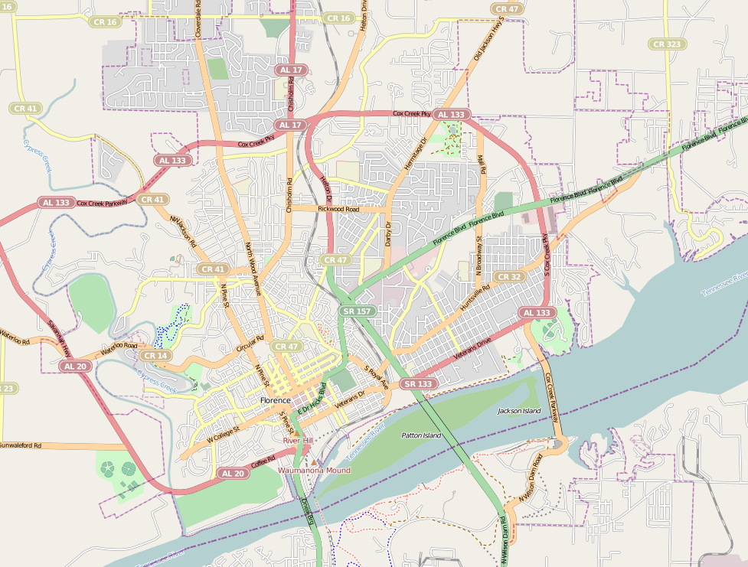
Node Key:
7P = Seven Points
CC = Cox Creek Parkway
CL = Cloverdale
DA = Darby Drive
DF = Downtown Florence
EF = East Florence
FB = Florence Blvd
CL
10
10
CC
15
10
12
5
10
8
WM
EF
NWF
7
MA
2
15
DA
12
8
8
15
8
9
11
7
12
10
7
10
7P
6
3
2
FB
6
PARK
11
HU
6
2
12
UNA
10
8
WD
SA
3
15
12
DF
Node Key (cont.):
HU = Huntsville Rd
MA = Mall
MP = McFarland Park
NWF = Northwest Florence
PARK = Random park
SA = Savannah Highway
UNA = UNA Campus
WD = Wilson Dam
WM = Wal-Mart
20
6
15
MP

Slide 12
Fin

